Slide 1
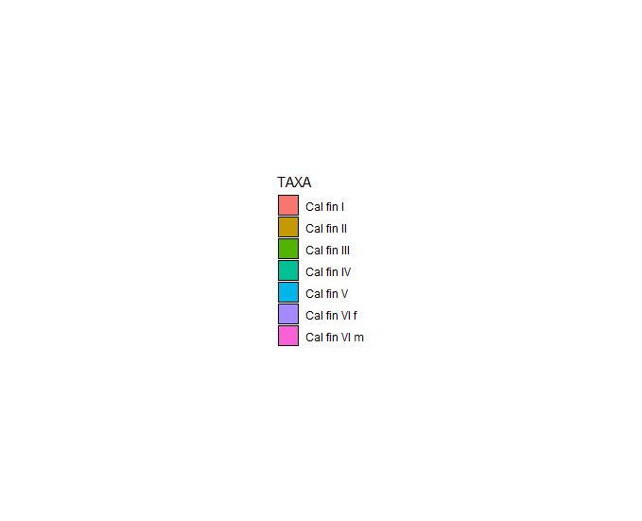
Cfin - BIONESS

Slide 2
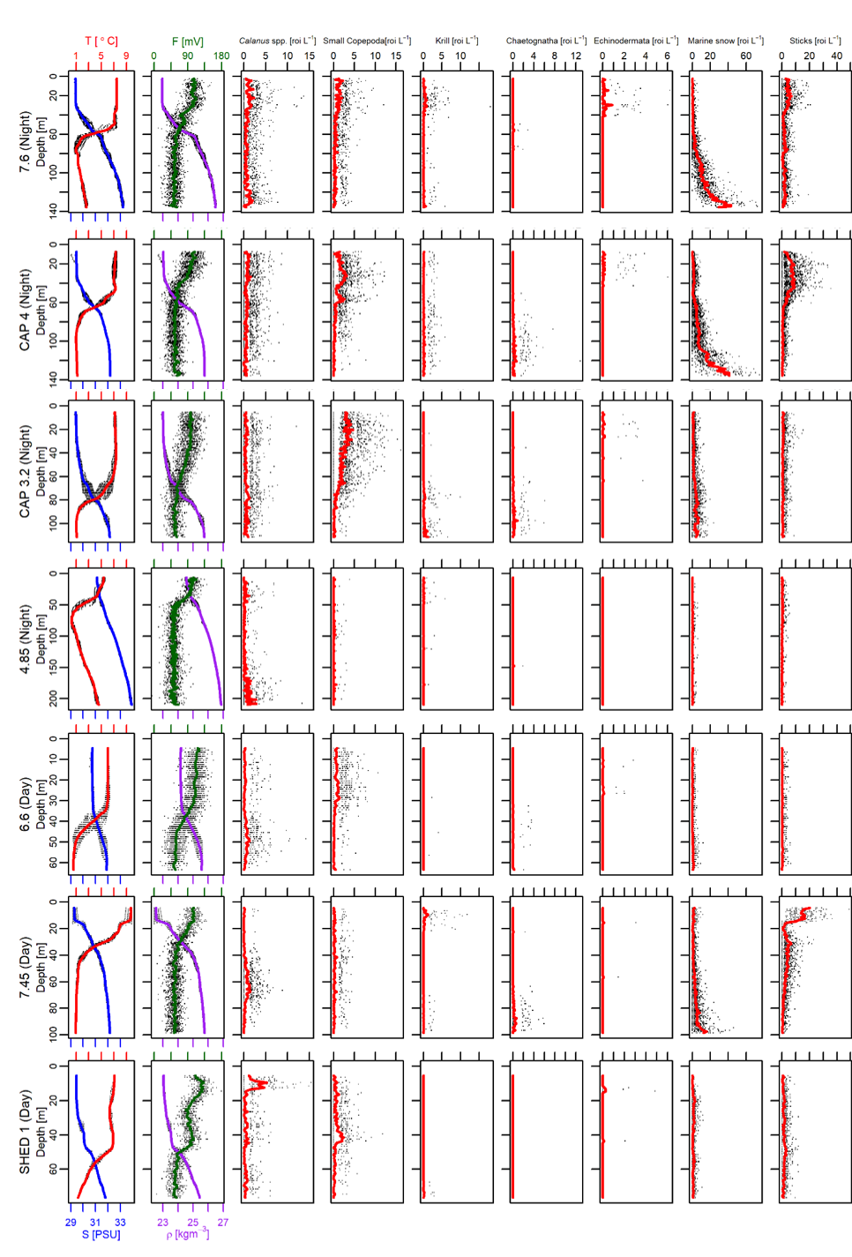
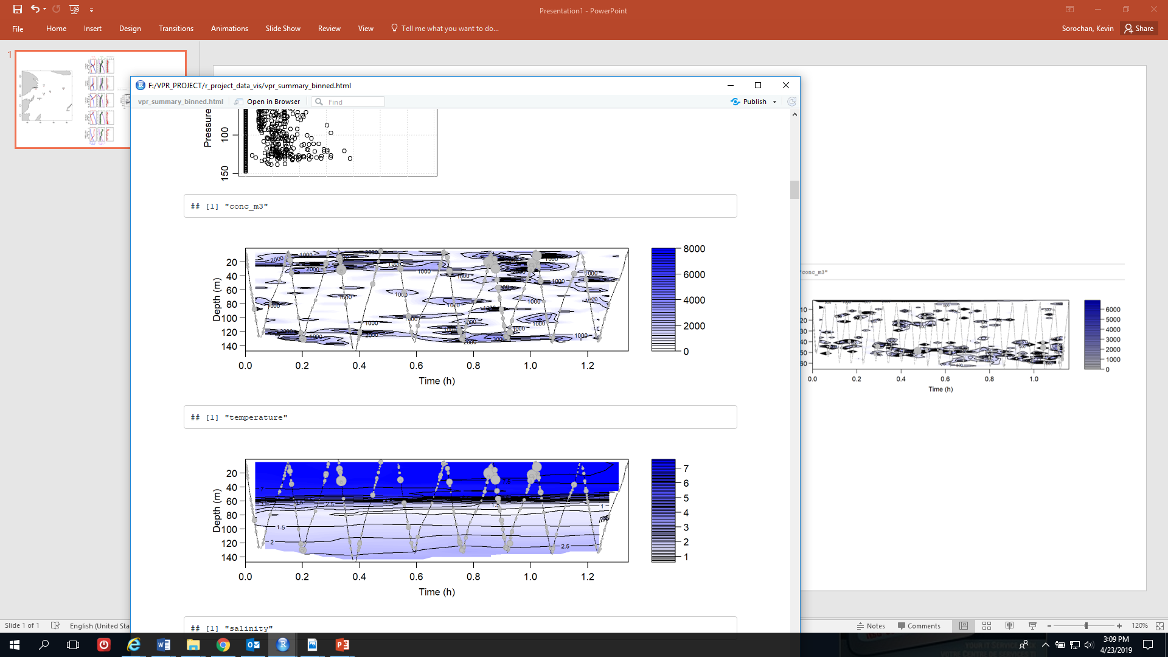
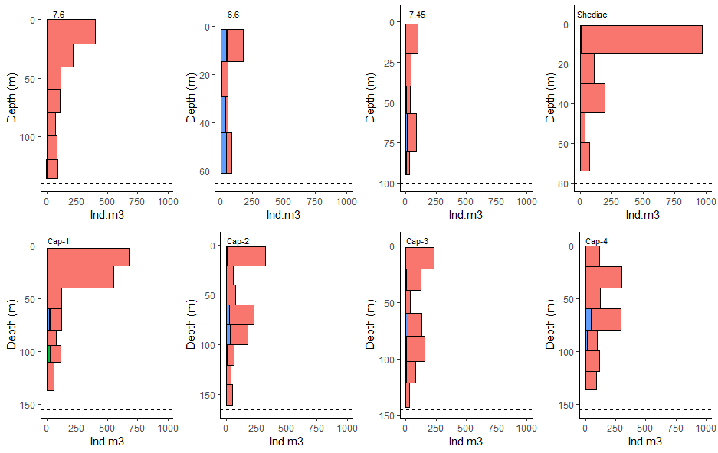
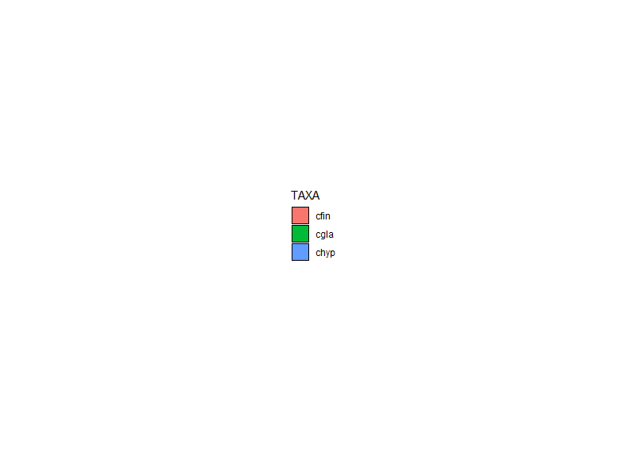
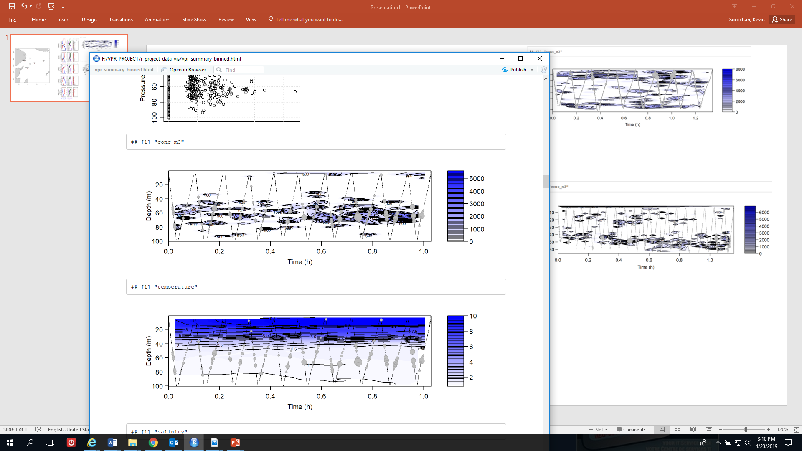
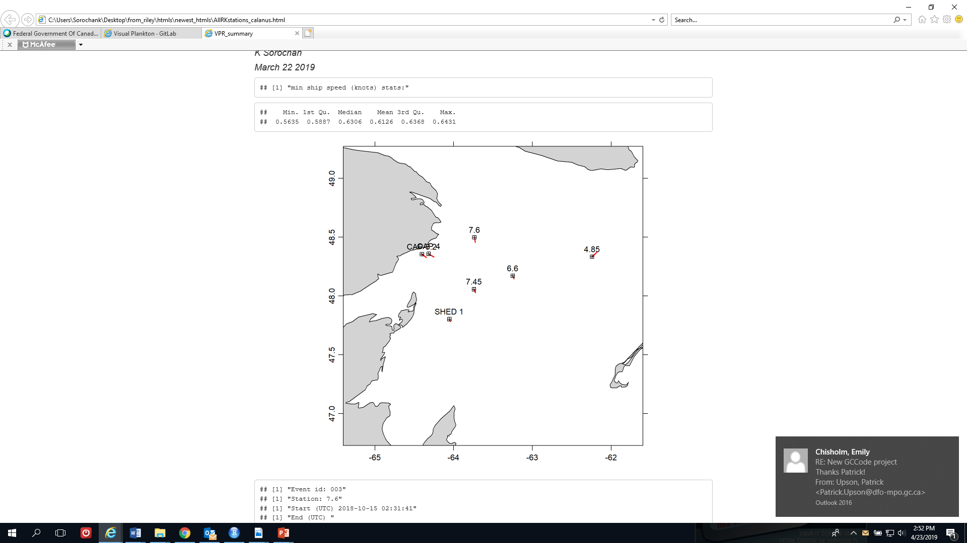
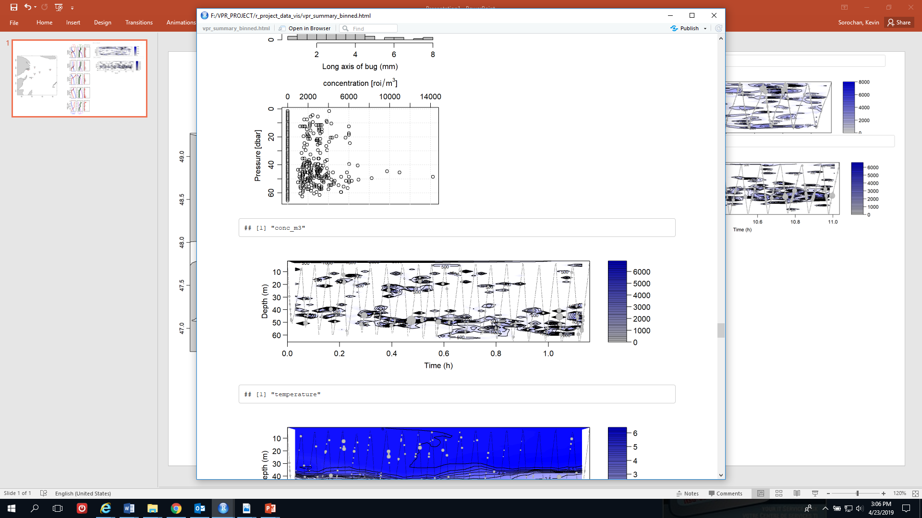
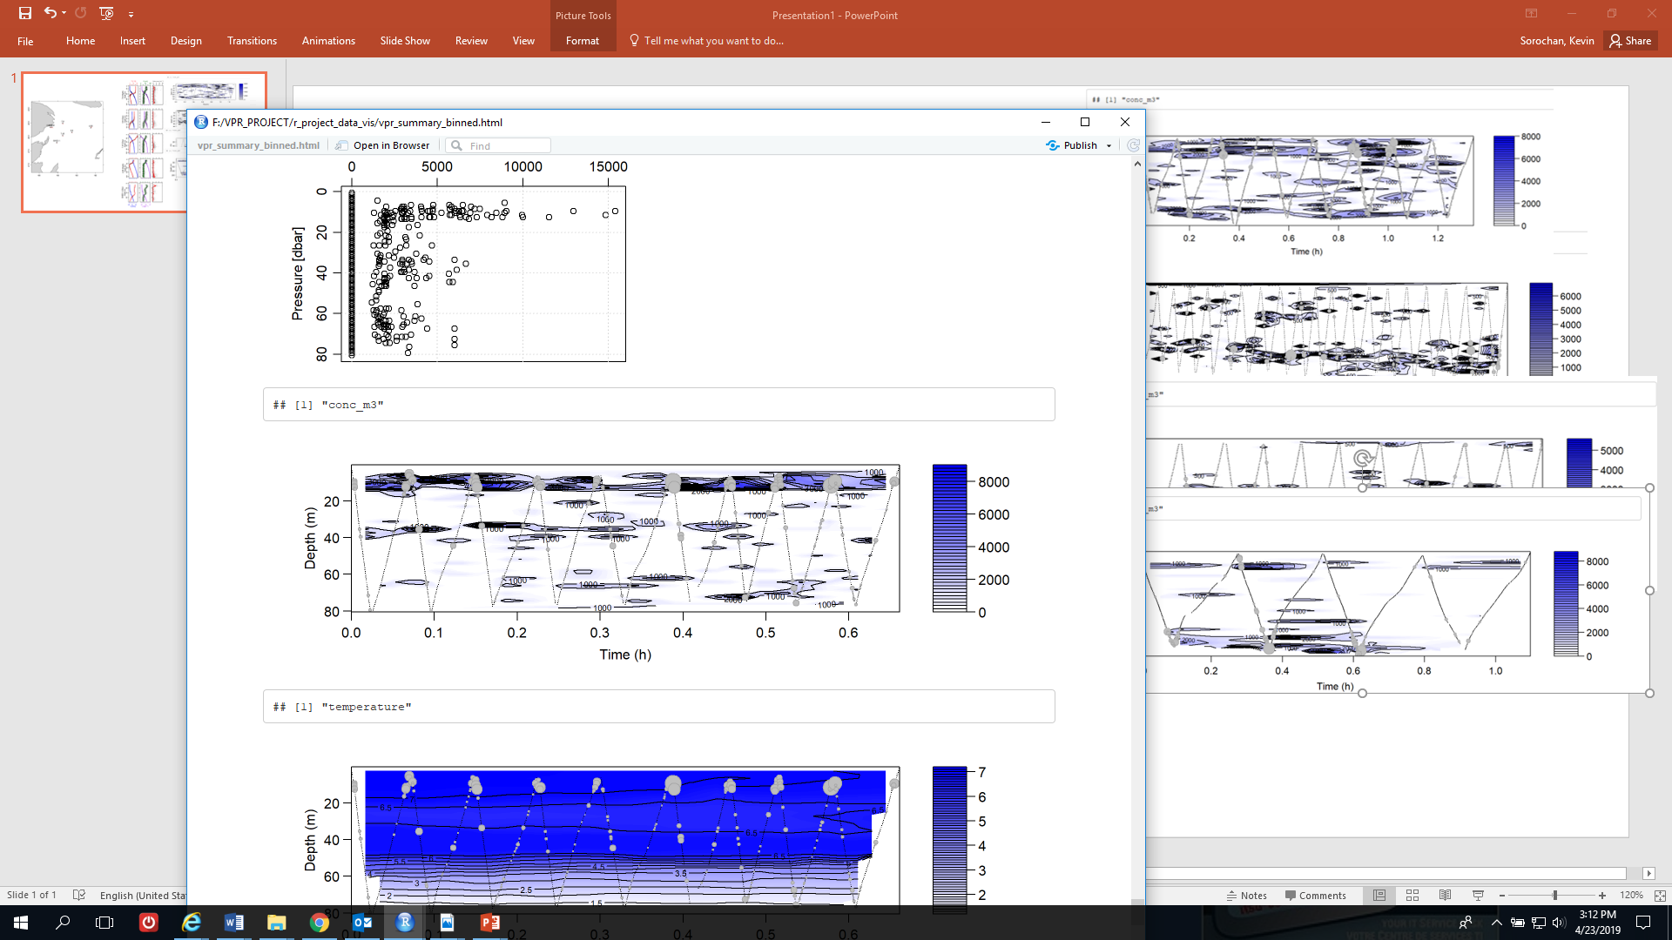
VPR
BIONESS
Calanus spp.
ind m⁻³
C. finmarchicus
C. hyperboreus
VPR transects

Slide 3
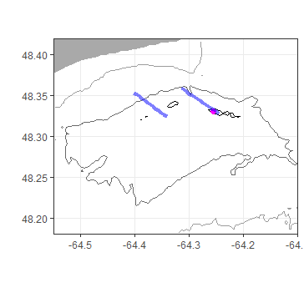
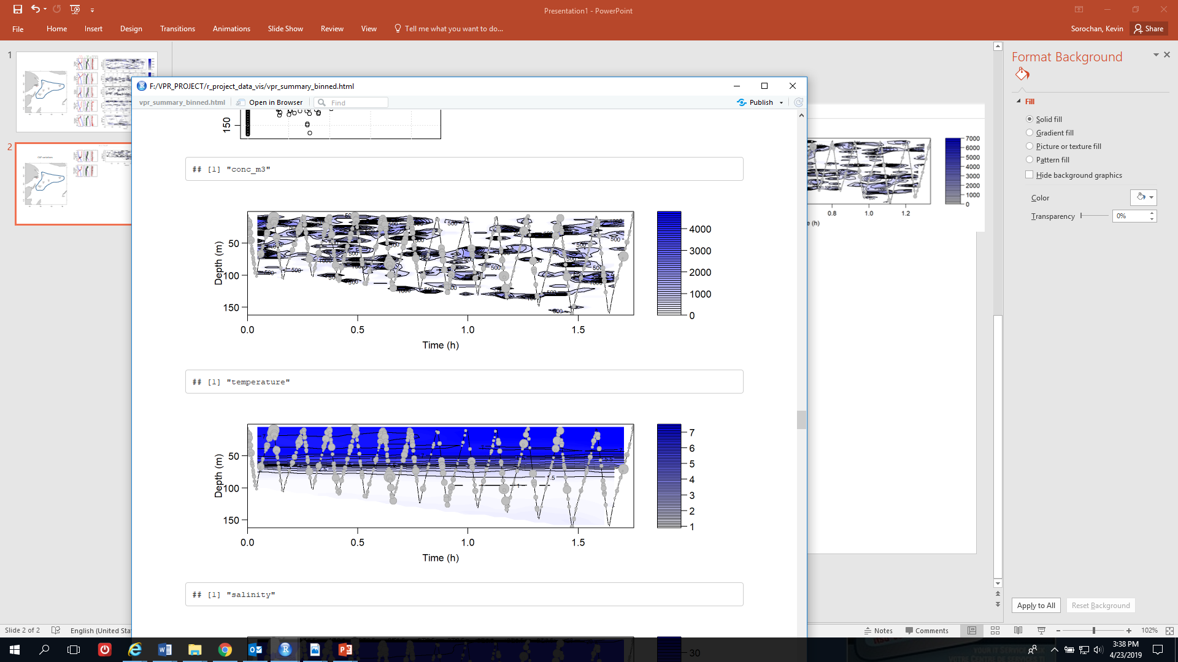
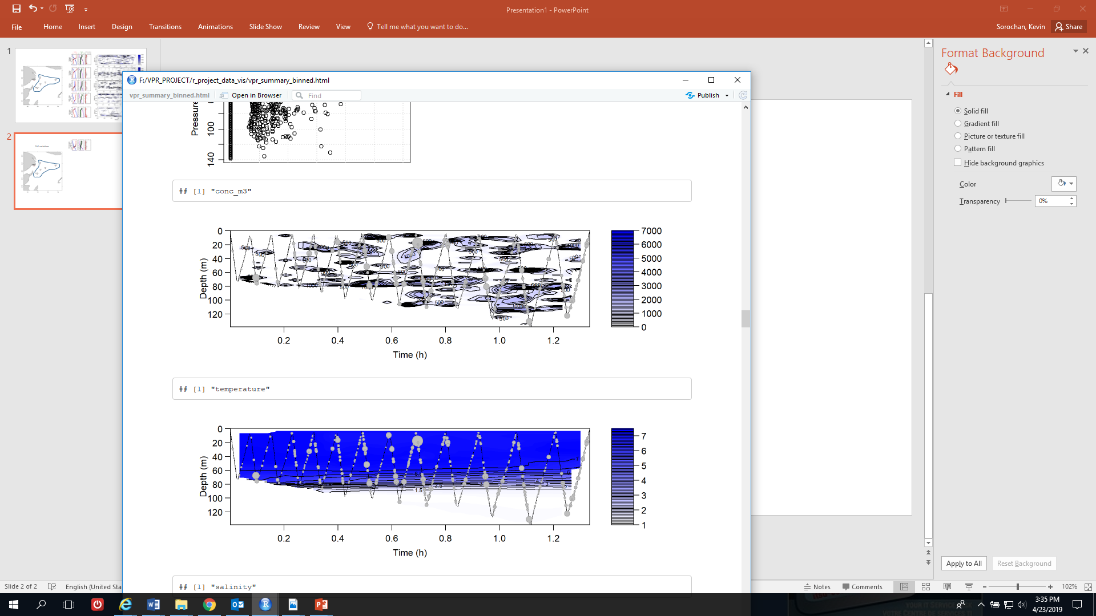
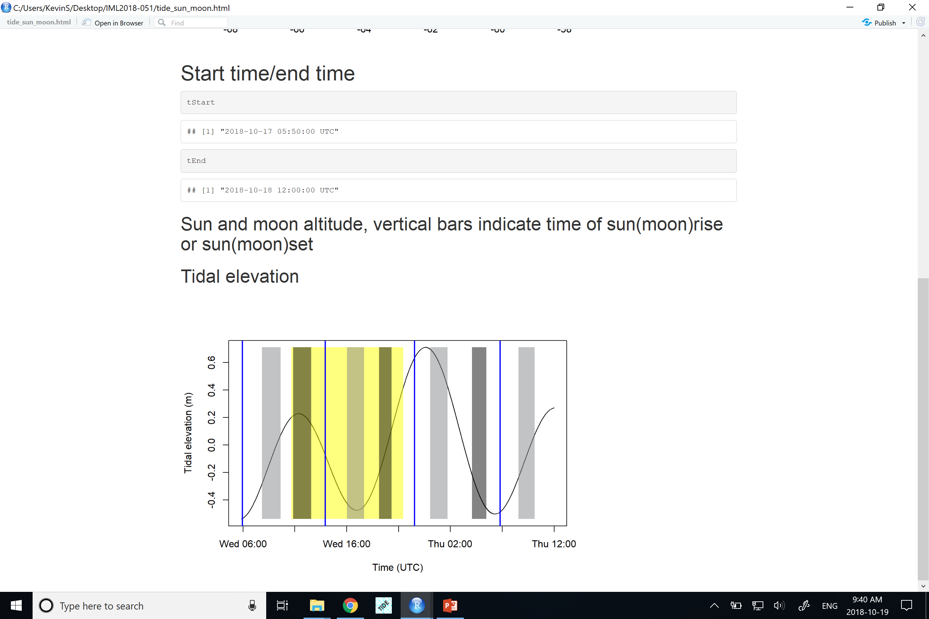
CAP 4
CAP 3.2
CAP variations (incomplete)
CTD, BIONESS
Calanus spp. (ind m⁻³)
CAP 3.2
CAP 4
CTD, BIONESS
Tidal elevation (m)

Slide 4
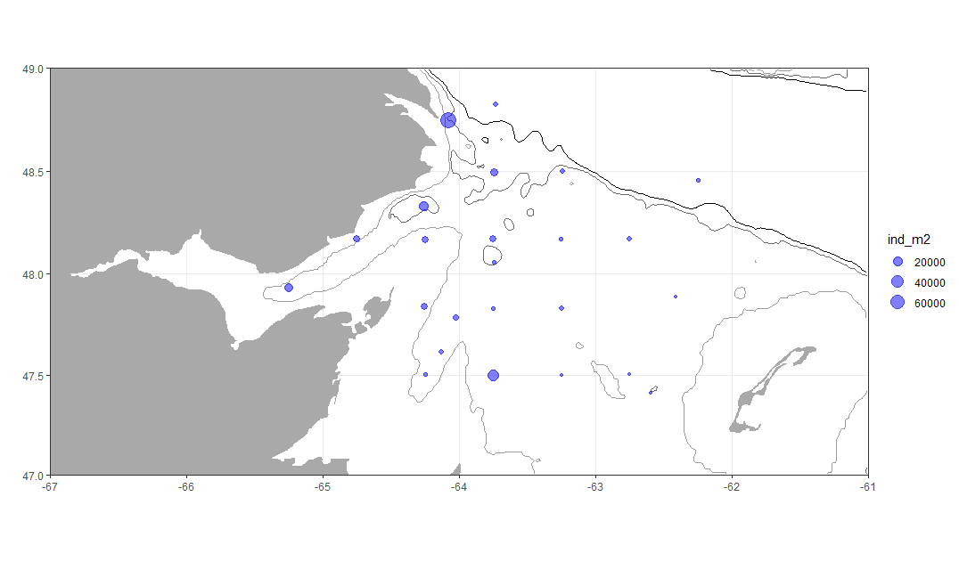
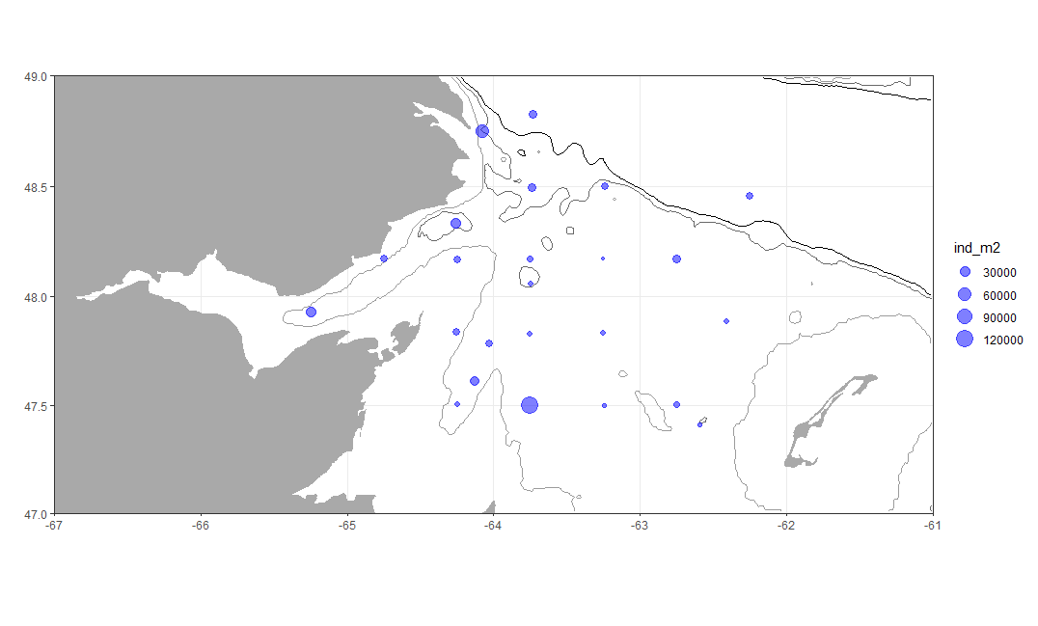
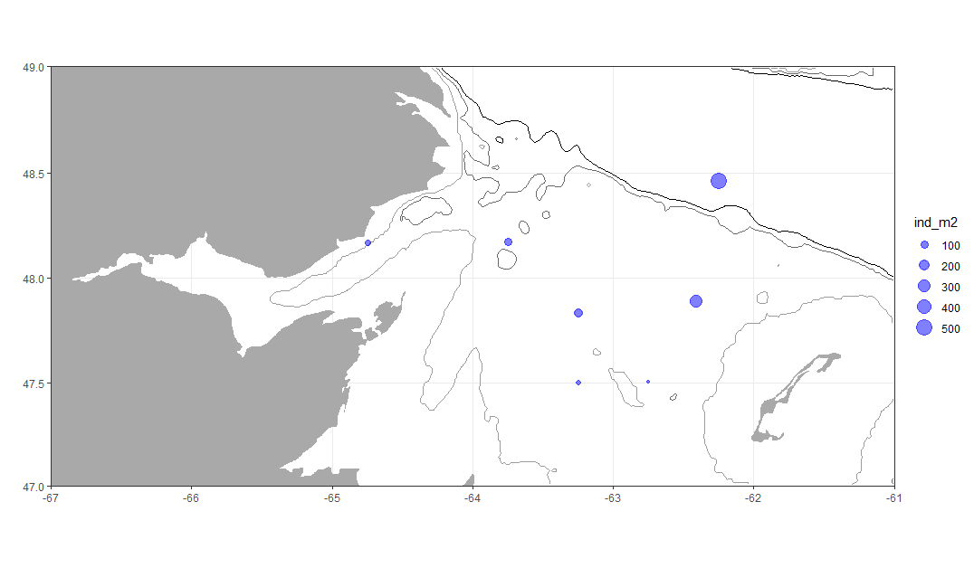
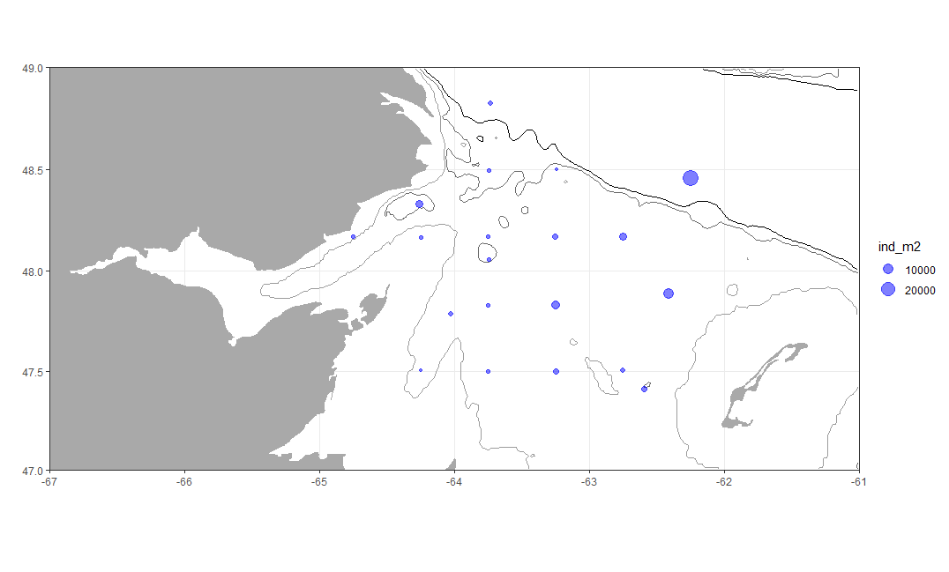
JNet survey (plankton tow from near bottom to surface)
C. finmarchicus/C. glacialis CI-CIII
C. finmarchicus/C. glacialis CIV-CVI
C. hyperboreus CI-CIII
C. hyperboreus CIV-CVI

